Slide 1
Model 6:Electric potentials
We will determine the distribution of electrical potential (V) in a structure.
z
y
V=To be specified
y=L
V=0
V=0
Insulation gaps
y
x=L
V=0
x
x
2003/ 1

Slide 2
Step 1: Find an equation and model
Consider the small cube below with sides of length δx, δy, and δx.
Let the vector D with components D_{x}, D_{y}, D_{z} be the electric flux density at the center of the cube.
z
D
δz
δy
δx
y
x

Slide 3
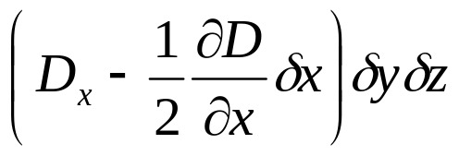
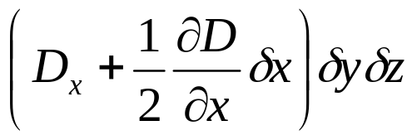
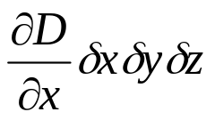
We calculate the flux through the faces of the cube:
The flux entering the cube through the left hand face is:
z
D
δz
The flux leaving the cube through the right hand face is:
δy
δx
y
x
The net flux through the cube in the x direction is:
-
=

Slide 4
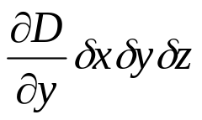
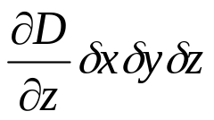
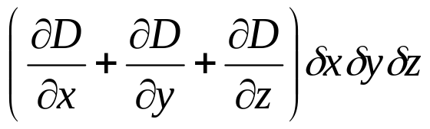
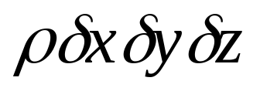
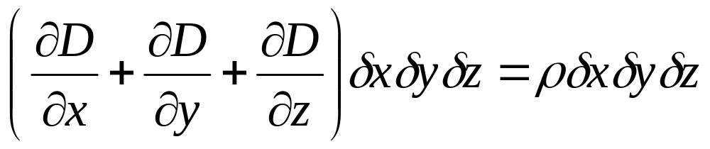
We get similar expressions in y and z.
The net flux through the element is:
The charge density is ρ. The total charge enclosed in the cube is:
This net flux must be equal to the total charge enclosed:

Slide 5
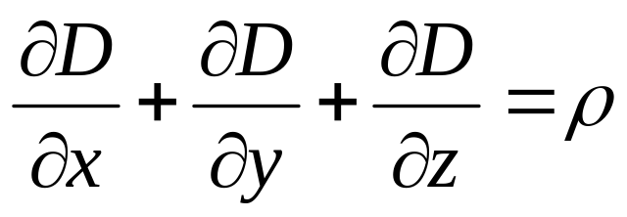

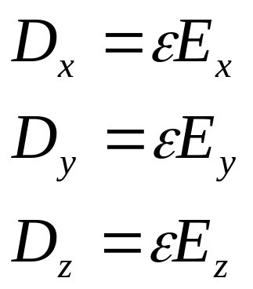
We can simplify the last expression:
(33)
The relationships between flux density D and field strength E is:

Slide 6
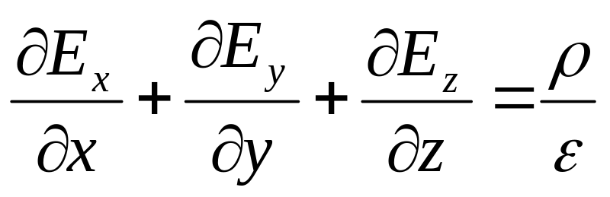
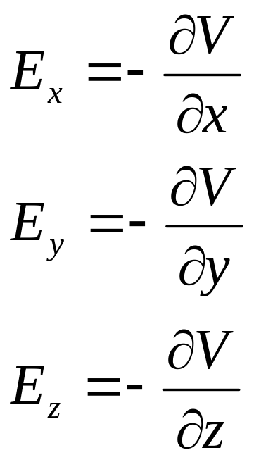
We can combine these with equation 33:
(34)
But field strength is equal to potential gradient:

Slide 7
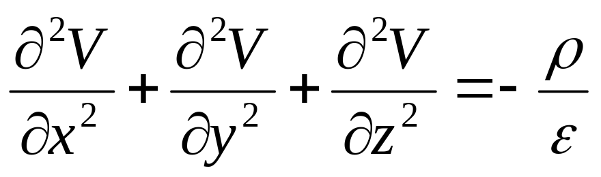
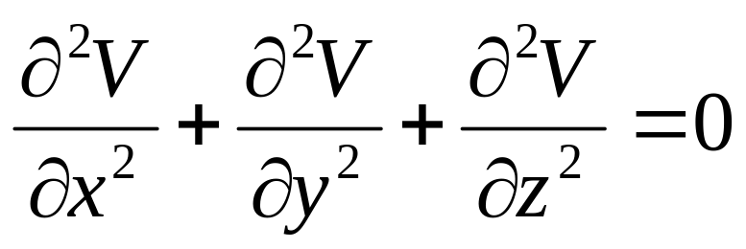
We substitute the last expressions into equation 34 to get Poisson’s equation:
(35)
When the charge density is zero (ρ=0) we get Laplace’s equation:
(36)

Slide 8
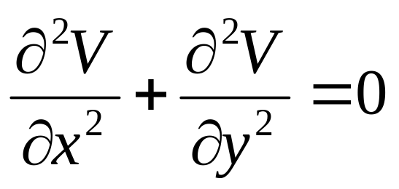
Further modelling considerations:
The structure is tall and slender and there is no charge within it.
y
V=To be specified
y=L
V=0
V=0
Use Laplace’s equation
Model the problem in 2-D
Insulation gaps
x=L
V=0
x

Slide 9
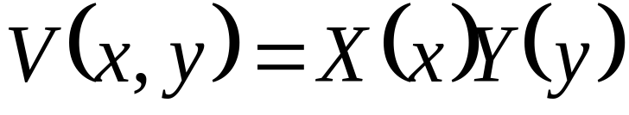
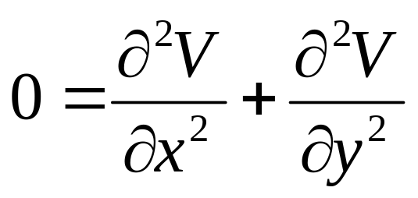
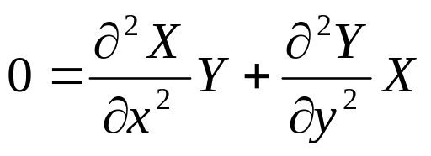
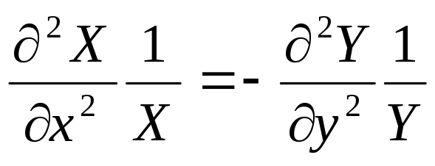
Step 2: General solution
Put into equation and then separate variables:

Slide 10
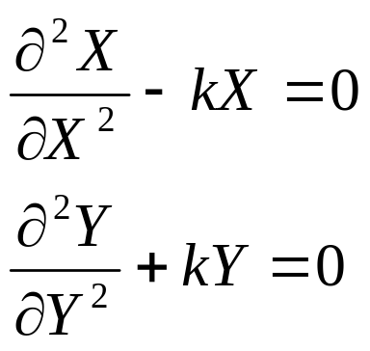
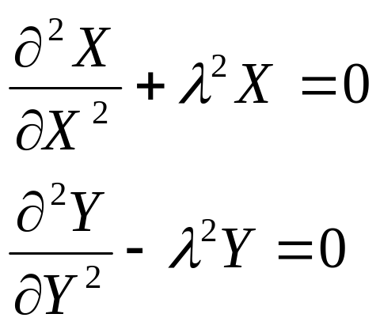
Both sides must be equal to the same constant~ k
In this case it makes sense to have k=-λ²

Slide 11
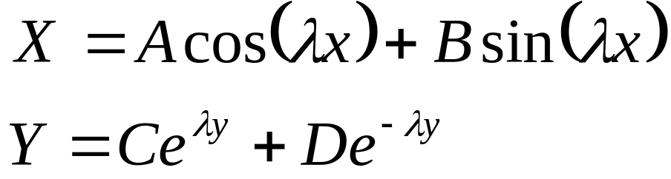
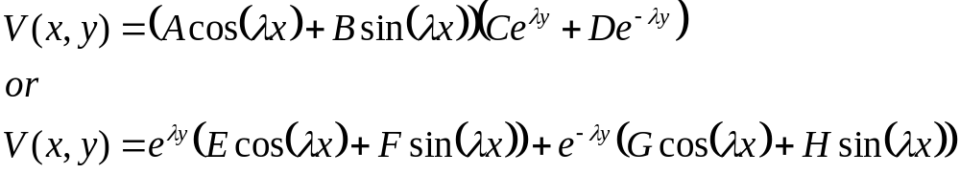
These equations have solutions:
Therefore

Slide 12
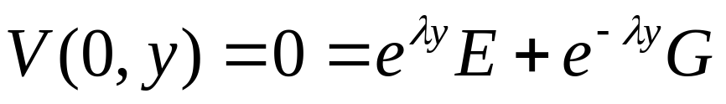
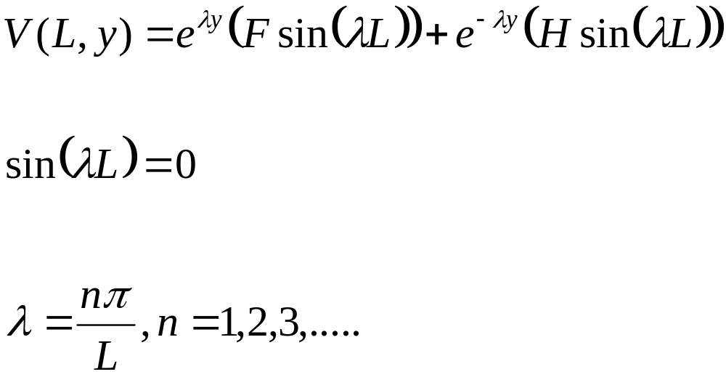
Step 3: Satisfy the boundary conditions
BC. 1: V(0,y)=0
E=G=0
BC. 2: V(L,y)=0

Slide 13
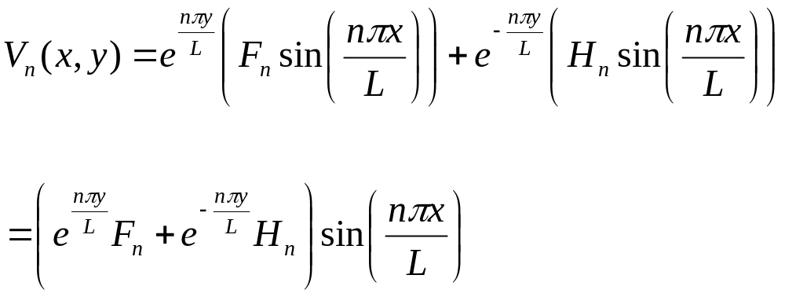
BC 2 continued

Slide 14
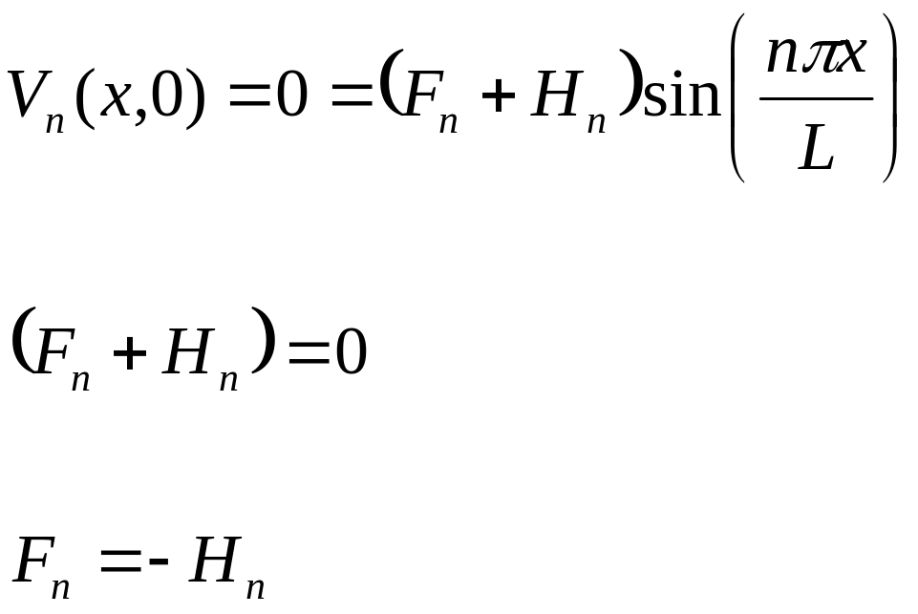
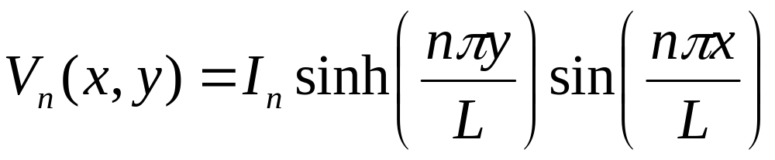
BC 3: V(x,0)=0
Therefore:

Slide 15
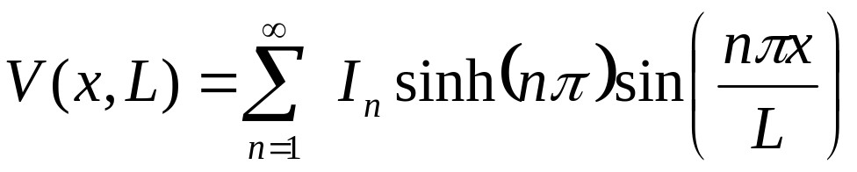
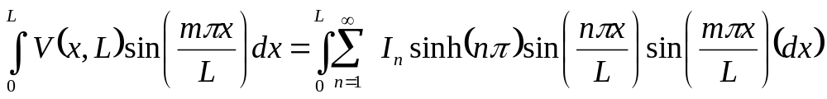
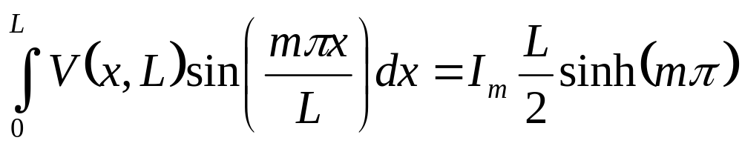
BC 4: V(x,L)=?
We will specify V(x,L) in class to determine the final solution V(x,y).
All terms are equal to zero except when n =m.
To be continued………

Slide 16
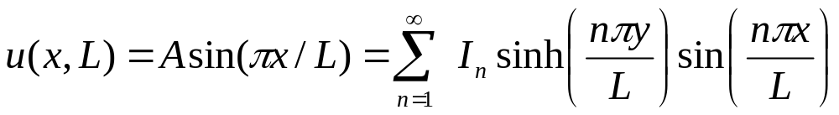
Let’s try u(x,L)=Asin(πx/L) for the 4th boundary condition
To evaluate I_{n} we post-multiply both sides by sin(mπx/L) and integrate across x=0 to L

Slide 17
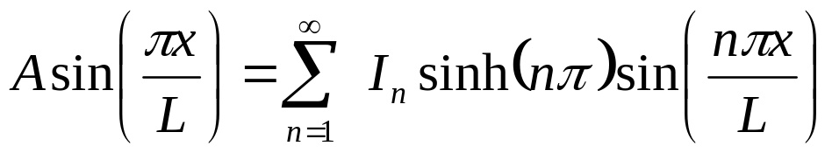
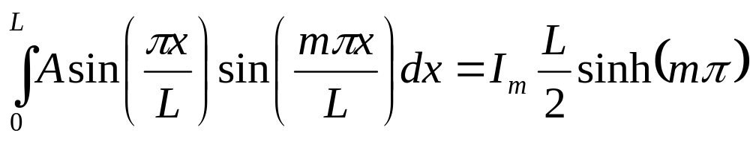
Let’s evaluate this:
From previous slide: To evaluate I_{n} we post-multiply both sides by sin(mπx/L) and integrate across x=0 to L:

Slide 18
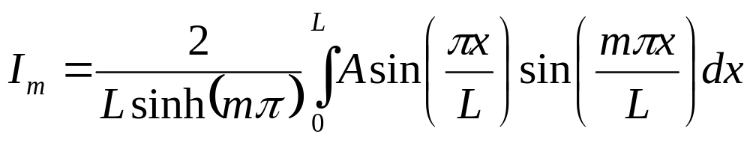
Rearrange:
The integral on the right is non-zero only when m=1

Slide 19
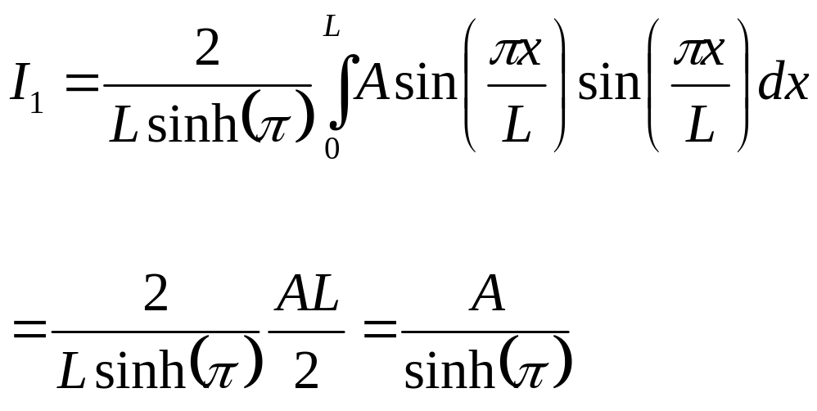
From previous slide: The integral on the right is non-zero only when m=1
The integral equals A*L/2 when m=1 and equals zero for all other values of m.

Slide 20
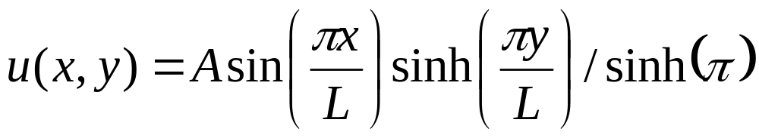
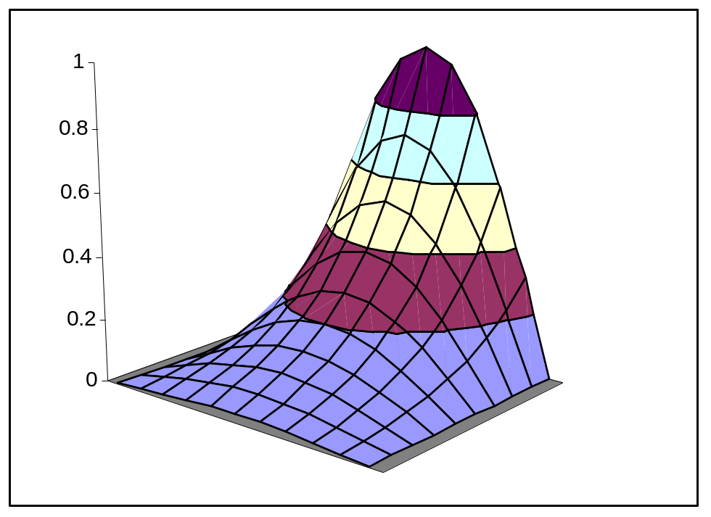
Final solution:

